Slide 1
Innovate like a leader
Pilar Somohano
WINvicta

Slide 2
What is innovation
What does it take
What does it mean to me

Slide 4
What is innovation

Slide 5
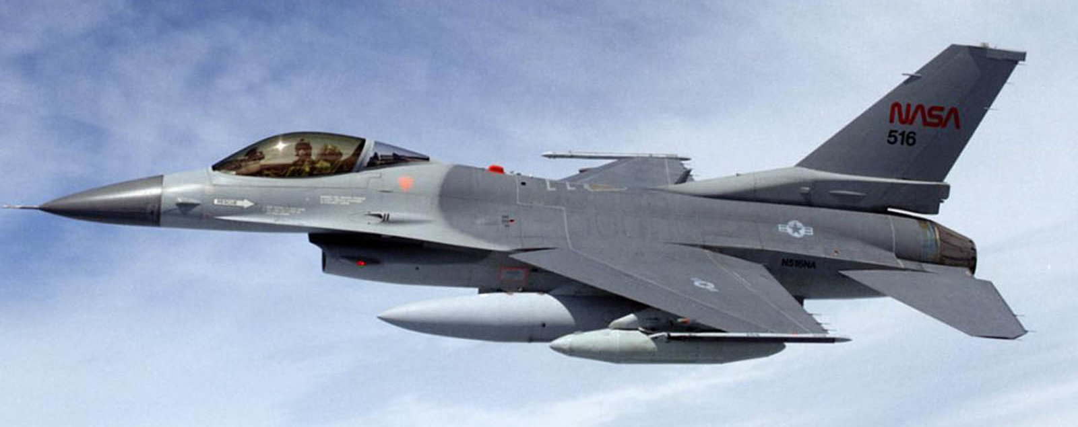
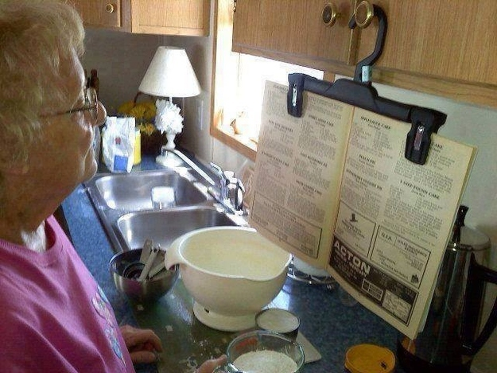
What’s innovation?
What about?...
If you don’t have a tool,
Make it!
No response to e-mail,
call them!
Need more headcount,
Optimize it!

Slide 6
Challenge the status quo
Counter intuitive concepts
Profit from your hobby
Raise your price to sell more units
Hire in the US to lower costs
Partner with your competitors
Humans can fly
Dress with a tent
Notes:
1: airplane, spaceships, gliders, balloons
2: GoPro, Nike
3: Strategic alliances (Cisco-Ericsson / McDonell/Boeing), Hillary campaign
4: Levi’s
5: Louis Vuitton, Junosphere
6: …

Slide 7
What does it take

Slide 8
How does innovation happen?
obstacles
failures
detractors
status-quo
limited resources
Need
vision
work
supporters
learnings
tenacity
teamwork
leadership

Slide 9
A cloud example…

Slide 10
A need
A large Service Provider expands its network via an acquisition
Goal:
Merge networks, save costs, drive innovation
Problem:
… there is no feasible way to simulate the migration
Years later, networks were still separate

Slide 11
A vision
Use the cloud to emulate the whole network at low cost
Goal:
Merge networks, save costs, drive innovation
Problem:
… but there is no feasible and safe way to simulate the migration
Years later, networks are still separate
What if…
We could emulate the whole network at low cost?
Could we use virtualization to do that?

Slide 12
An obstacle
I just can’t copy thousands of nodes and configs manually

Slide 13
The work
Market Analysis
Technical Feasibility
Funding

Slide 14
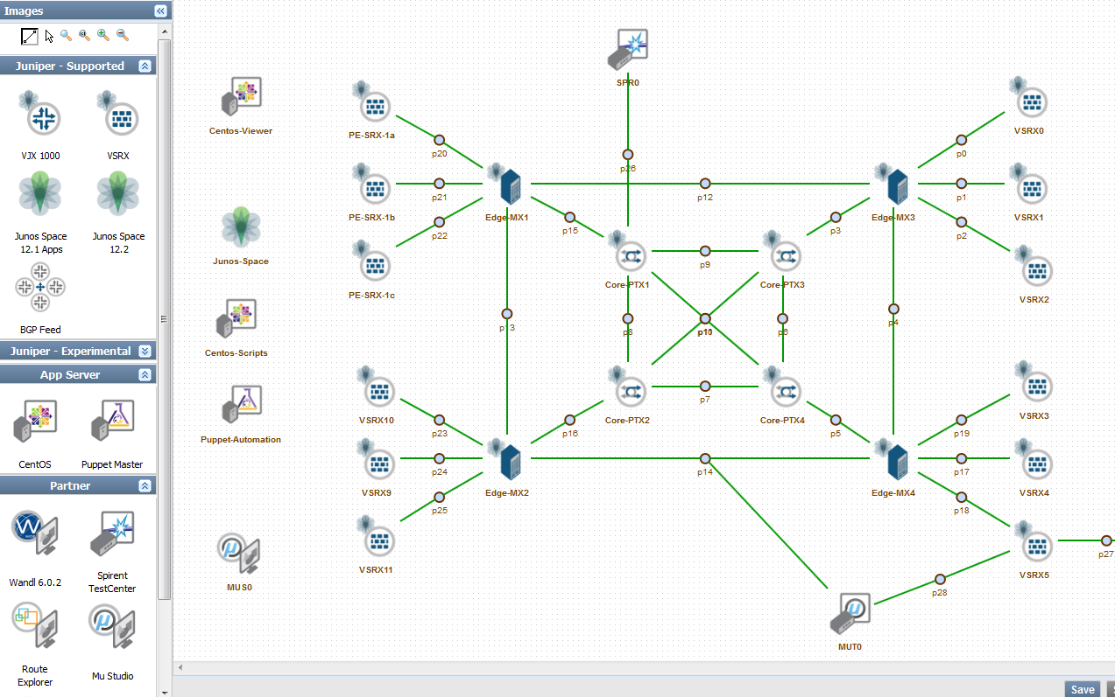
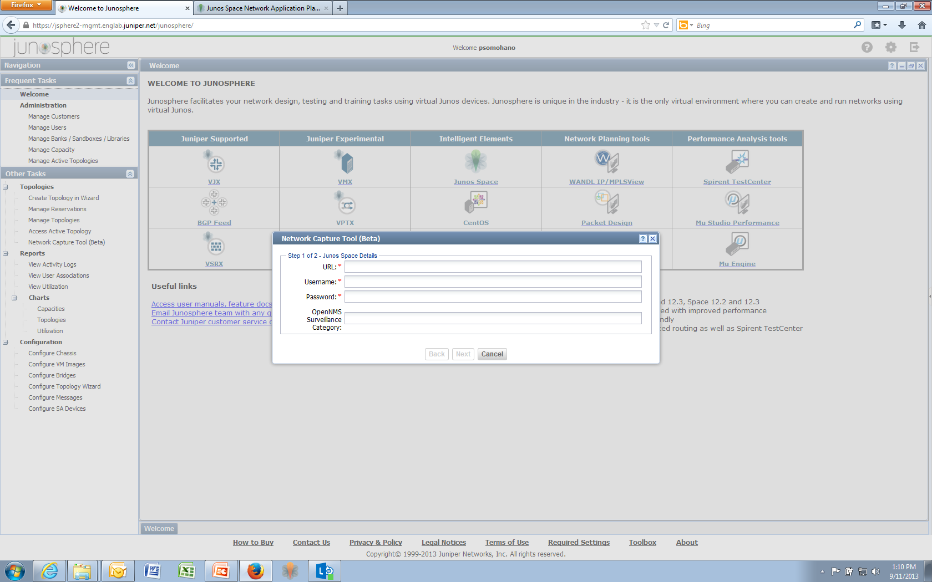
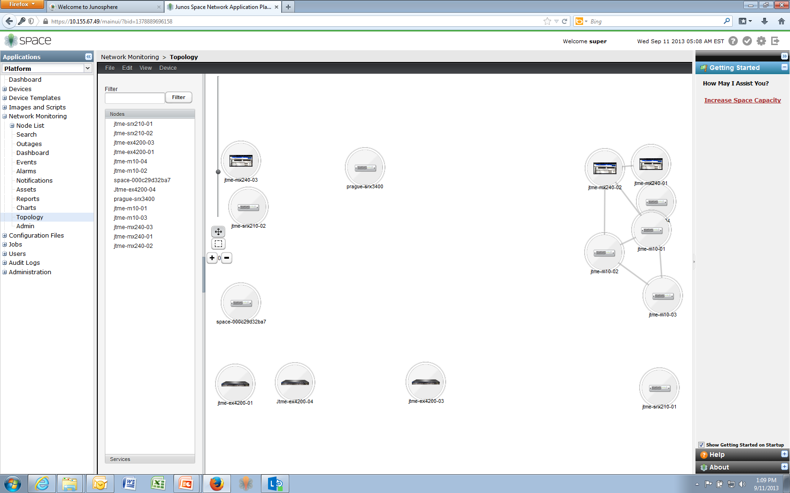
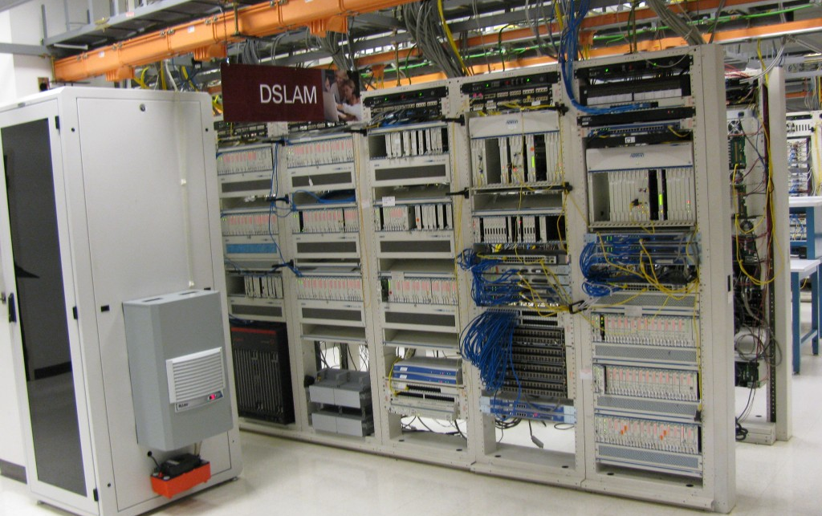
Leadership Results
Notes:
https://jsphere2-mgmt.englab.juniper.net/junosphere/
Space URL - https://10.155.67.49
Username/Password – super/juniper123

Slide 15
Leadership Results
5 Pioneers
1 million virtual machines
$1 / virtual machine day
5 Business Units Collaborating
500 Customers
5 Top Euro Service Providers
5 Ecosystem Partners
5 US Top
Service Providers
1 Patent

Slide 16
What does it mean to you?

Slide 17
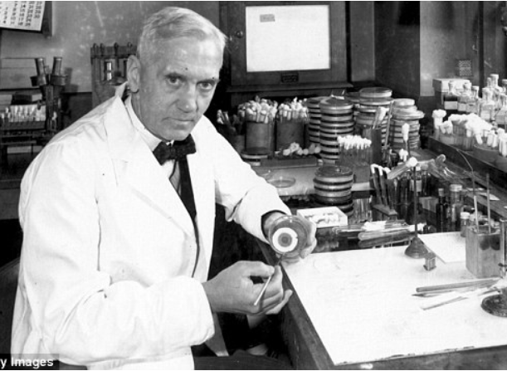
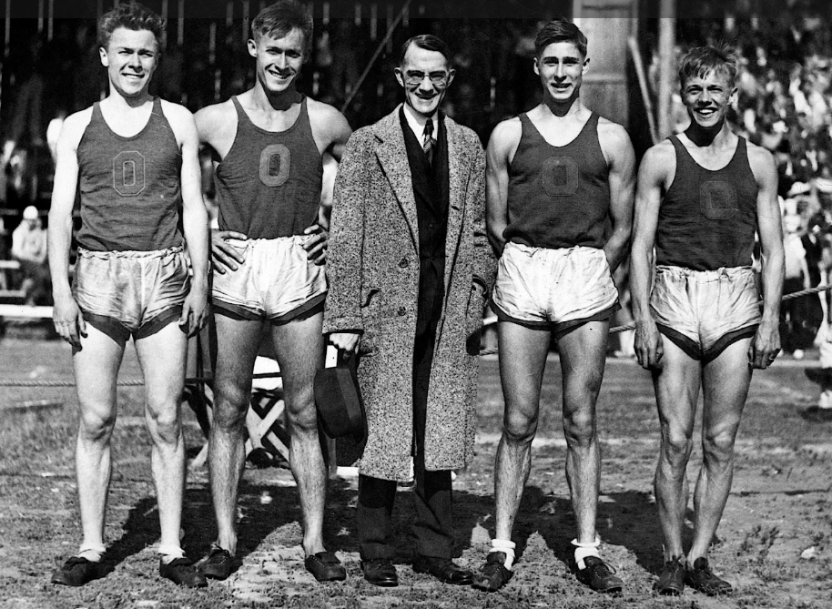
Find a need - Have a passion
Observe around you and stay curious
Look beyond your day-to-day work
Alexander Fleming
What’s happening here?
Penicillin
Bill Bowerman
I need better affordable shoes
Nike
Nick Woodman
Can’t pay for the camera rental
GoPro
Need
vision
work
Notes:
Alexander Fleming
Nick Woodman
Bill Bowerman

Slide 18
Exercise: How can I lead the way
Think of needs and events in your environment
How you do things every day
What could improve in your workgroup
What do you see in your industry
How are things in your community
Need
vision
work

Slide 19
From need to vision
What if…
To the extent of your possibilities, what can you do?
If you had full power, what would you do?
Who could help?
Need
vision
work

Slide 20
Tell the world – work with others
Use innovation to help others
and build leadership
This solution is great for me… who else can benefit from it?
Share it!
Teach them how to use it
Let others know about it
Need
vision
work

Slide 21
What would I ask for?
The opportunity to expand the use of my solution
A team or budget to continue developing it
Access to special training that will help me do more
Introduction to others who would be interested and could help me
Ideas to leverage from the innovation
Need
vision
work

Slide 22
Innovate like a Leader
Enable yourself
you don’t need permission to help
Tell the world
share your solutions and make an impact
Do more
build partnerships to achieve more
Organizations and people need solutions!
Innovation is welcome

Slide 23
How will you begin?

Slide 24
Thank you!

Slide 25
Let’s make it happen!
winvicta
Pilar Somohano
508-223-7665
www.winvicta.com
psomohan@winvicta.com

